Slide 1

RetailIQ – Full-Cycle E-Commerce Customer & Sales Analytics
Final Project Review | Department of CSE | [Koneru Lakshmaiah Education Foundation]
TEAM MEMBERS
2420030630 – Vishnu Priya Kodali
2420030185 – Ivaturi Vennela
2420030067 – Lakshman Angara
Guide: Dr.N.Sunanda, Associate Professor |Academic Year: [2026–27]
Notes:
Title slide. Replace all bracketed text. Use the full project title, list every team member with registration number, and name your guide. Insert the institution logo in the dashed box.

Slide 2
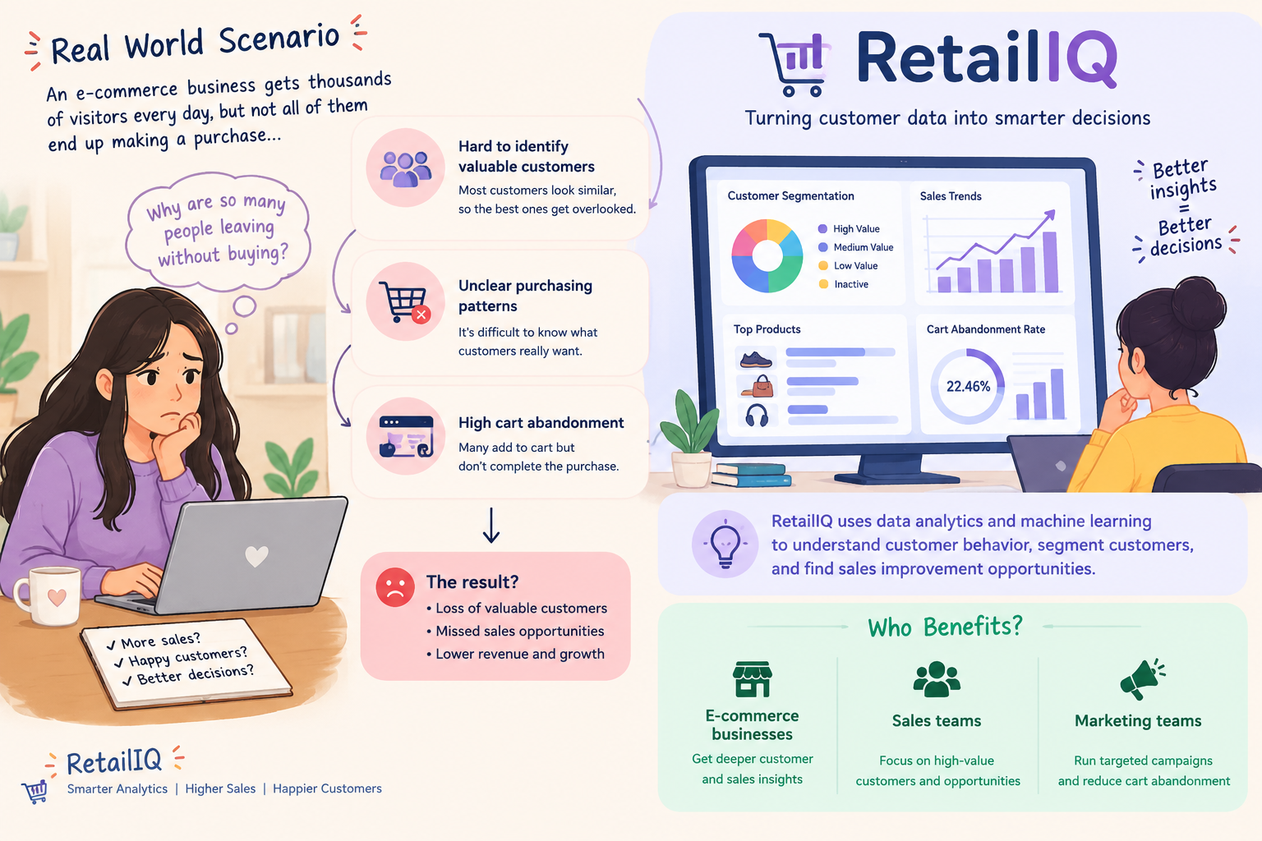



Introduction & Problem Statement
[
Background
RetailIQ uses Data Science and Machine Learning to analyze e-commerce sales and customer behavior. It helps identify valuable customers, understand purchasing patterns, and improve sales and customer retention.
Problem Statement
E-commerce businesses struggle to identify valuable customers, understand purchasing behavior, and detect cart abandonment.RetailIQ uses data analytics and machine learning to generate actionable customer and sales insights.
Motivation / Need
E-commerce businesses, sales teams, and marketing teams benefit from better customer insights and targeted strategies.Businesses may lose valuable customers, face higher cart abandonment, and miss sales opportunities.
Notes:
State the domain, the exact problem and why it matters. Keep it to about 2 minutes. Add one real-world statistic if you can, with a citation.

Slide 3


Objectives & Scope
Objectives
1
To Analyze e-commerce customer behavior and sales patterns using exploratory data analysis.
2
To Develop RFM-based customer segments using K-Means clustering to identify distinct purchasing groups.
3
To Evaluate K-Means and Agglomerative Clustering using Silhouette, Davies–Bouldin, and Kalinsky–Harabasz scores.
4
To Develop an interactive Streamlit dashboard to visualize sales performance, customer segments, and actionable business recommendations.
Notes:
Objectives should be measurable and start with action verbs. The scope slide tells the panel what you did and did not attempt.

Slide 4

Literature Survey
S.No | Author(s) & Year | Method / Technique | Key Findings | Limitation / Gap
1 | Jun Wu et al. (2021) | Improved RFM, K-Means++ | Improves customer-value identification. | Identifies factors influencing cart abandonment.
2 | Zengyuan Wu et al. (2022) | Improved RFM features, K-Medoids clustering | Enhances e-commerce customer segmentation. | Focuses on clustering rather than an integrated analytics dashboard.
3 | Gomes & Meisen (2023) | Systematic literature review | Reviews customer-segmentation methods and evaluation metrics. | No universal agreement on the best evaluation metrics.
4 | Chopra et al. (2024) | Systematic literature review, lexicometric analysis | Identifies factors influencing cart abandonment. | Further research across contexts is needed.
Research Gap
Existing studies primarily focus on customer segmentation, clustering techniques, or cart abandonment separately. Limited integration of sales analysis, customer behavior, segmentation, and model evaluation leaves room for a unified approach. RetailIQ combines these components to provide comprehensive e-commerce insights. An interactive Streamlit dashboard presents actionable insights to support sales improvement and customer retention.
Notes:
Summarise four to six relevant papers or existing systems. End with the research gap, because that gap justifies your project.

Slide 5





Proposed System & Methodology
STEP 1
STEP 2
STEP 3
STEP 4
STEP 5
Define Problem
Collect Data
Design
Implement
Test & Evaluate
Validate revenue calculations and compare clustering using Silhouette, Davies–Bouldin, and Calinski–Harabasz scores.
Identify customer behavior, sales, and cart-abandonment challenges.
Load and inspect Ecommerce.csv (25,000 rows, 29 columns).
Plan EDA, RFM, K-Means, model comparison, and Streamlit dashboard.
Build preprocessing, analysis, segmentation, evaluation, and dashboard modules.
Key Novelty / Contribution
RetailIQ integrates sales analysis, customer behavior, RFM-based segmentation, and clustering model comparison into a single analytics workflow. An interactive Streamlit dashboard converts the results into actionable insights for sales improvement and customer retention.
Notes:
Walk through the five steps left to right. Rename the steps to match your project (for example, Requirement Analysis, Design, Coding, Testing, Deployment). End with your novelty.

Slide 6
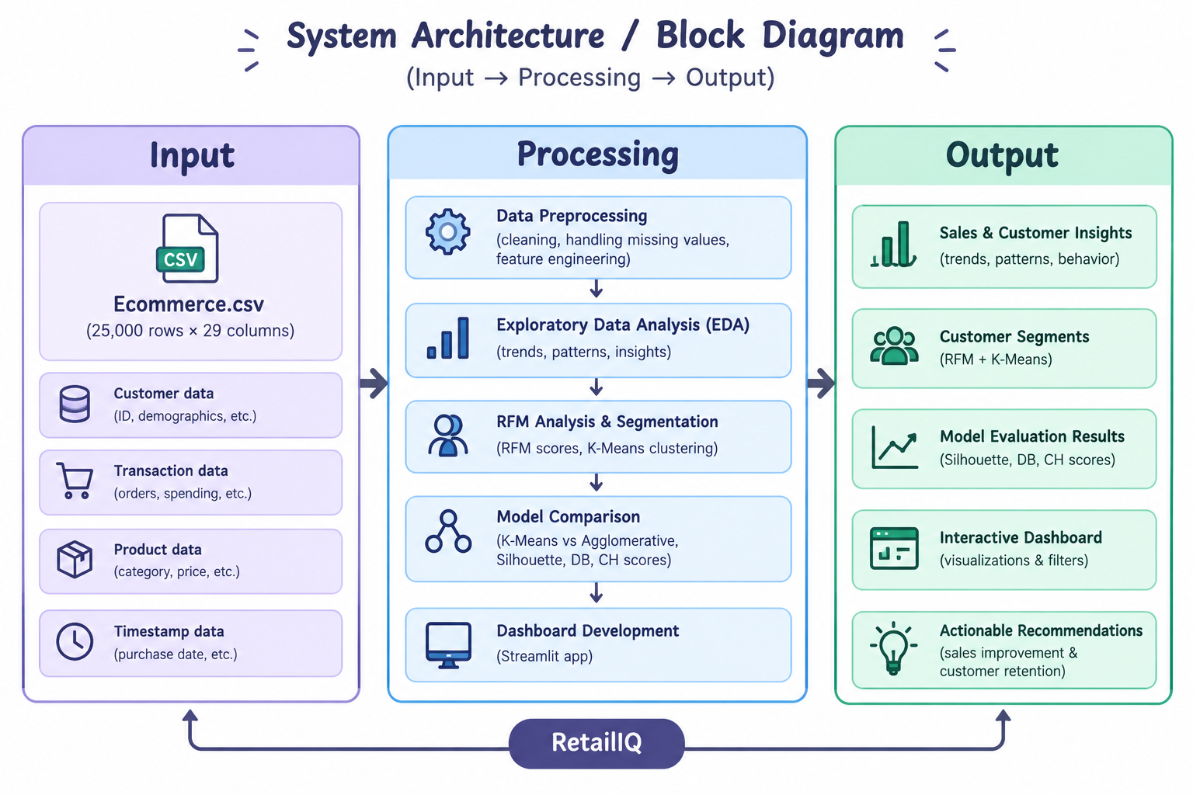
System Architecture
[Insert system architecture / block diagram
(Input → Processing → Output)]
Components
1
Data Preprocessing
Cleans data, handles missing values, and prepares features for analysis.
2
Sales & Customer Analysis
Performs EDA to identify sales trends, customer behavior, and cart abandonment.
3
Customer Segmentation & Model Evaluation
RFM-based segmentation and clustering evaluation.
4
Interactive Dashboard
Streamlit dashboard for sales insights, customer segments, and recommendations.
Notes:
Insert a clear block diagram: input, processing, storage, output. Number each block and explain them on the right. Redraw the figure yourself rather than copying it.

Slide 7


Hardware & Software Requirements
Hardware
Software & Tools
Libraries / Frameworks
Processor / RAM / GPU: Standard laptop, 8 GB RAM recommended, GPU not required
Storage: Local storage for dataset and project files
Sensors / Boards / Devices: Not applicable
Network / Peripherals: Internet connection, keyboard, and mouse
Operating System: Windows 11
Language and Version: Python 3.x
IDE / Notebook: Anaconda Jupyter Notebook, VS Code
Version Control: GitHub, if used
Libraries: Pandas, NumPy, Matplotlib, Seaborn, Scikit-learn
Framework: Streamlit
Database / Cloud: Not applicable; local CSV dataset
Deployment / Platform: Local machine using Anaconda Jupyter Notebook and Streamlit (localhost).
Notes:
List only what you actually used, with versions. For a pure software project, shorten the hardware list and add cloud or deployment resources.

Slide 8
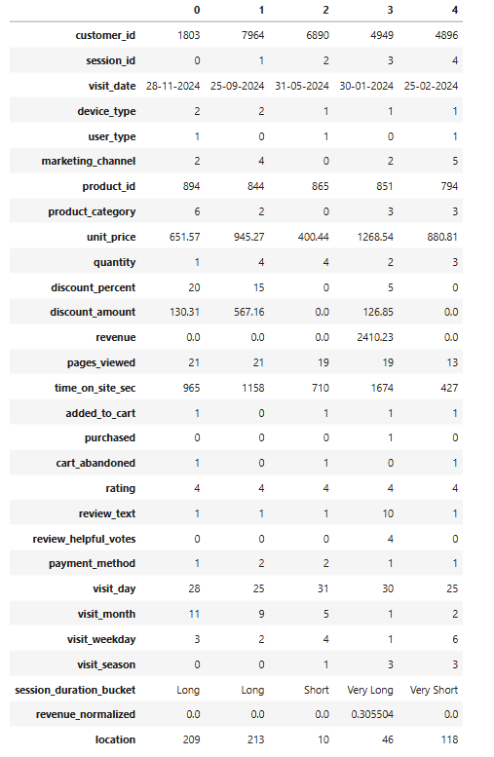
Dataset / Data Understanding
[25,000]
[9]
Records (rows)
Features (columns)
[0]
[No predefined target class; K-Means performs unsupervised clustering into 5 customer segments.]
Missing values
Target classes
Source: Kaggle – E-Commerce Customer Behavior & Purchase Dataset
Features: Customer details, purchase behavior, session activity, product information, and RFM metrics; no predefined target variable.
Quality: 25,000 rows, 29 columns, 0 duplicate rows; 0 missing values checked during preprocessing. Class imbalance is not applicable to the unsupervised K-Means model.
Notes:
Explain where the data came from and what it contains. Show a screenshot of the first rows or the info summary. For non-data projects, replace this slide with “Requirement Analysis” or “Input Specification”.

Slide 9
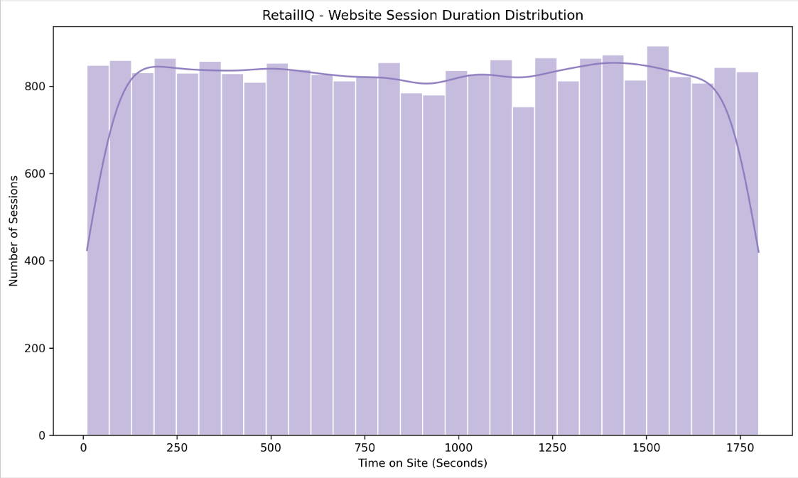
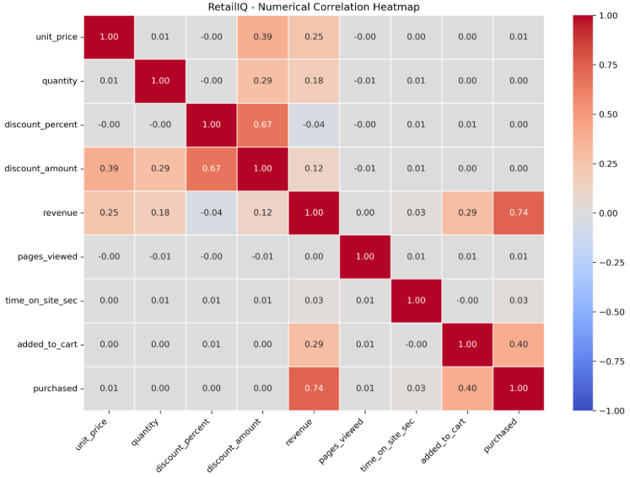



Data Preprocessing & Exploratory Analysis
[Insert correlation heatmap / outlier box-plot]
Cleaning
Transformation
Feature Selection
Missing values checked and handled during preprocessing.
Duplicate rows: 0.
Outliers examined; final RFM model used uncapped values.
Created RFM features: Recency, Frequency, and Monetary.
PCA reduced data to 2 components for visualization (85.32% variance explained).
Selected RFM features for K-Means clustering.
Final model: 5 customer clusters.
Notes:
Show two or three plots that tell a story: distributions, correlations, outliers. Explain what each plot told you and what you did about it.

Slide 10
Module-wise Description
1
Data Preprocessing
2
Exploratory Data Analysis (EDA)
Purpose: Cleans and prepares the e-commerce dataset for analysis.
Input → Output: Raw Ecommerce.csv → Cleaned dataset
Developed by: [Lakshman Angara]
Purpose: Analyzes sales trends, product performance, customer behavior, and cart abandonment.
Input → Output: Cleaned dataset → Sales and customer insights
Developed by: [Ivaturi Vennela]
3
RFM Feature Engineering
4
Customer Segmentation
Purpose: Calculates Recency, Frequency, and Monetary values for customer segmentation.
Input → Output: Purchase records → Customer-level RFM features
Developed by: [Ivaturi Vennela]
Purpose: Applies K-Means clustering to group customers based on purchasing behavior.
Input → Output: RFM features → Five customer segments
Developed by: [Lakshman Angara]
Notes:
Divide the project into three to five modules. For each, state its purpose, inputs, outputs and who built it. Duplicate a card if you have more modules.

Slide 11
Module-wise Description
5
Model Evaluation
6
Comparative Analysis
Purpose: Compares clustering models using evaluation metrics.
Input → Output: Clustering results → Performance scores and model comparison
Developed by: [Vishnu Priya Kodali]
Purpose: Compares K-Means configurations and Agglomerative Clustering results.
Input → Output: Clustering models → Comparative performance results
Developed by: [Vishnu Priya Kodali]
7
Interactive Dashboard and Business Recommendations
Purpose: Visualizes sales insights, customer segments, and actionable business recommendations.
Input → Output: Processed data and model results → Interactive dashboard and recommendations
Developed by: [Vishnu Priya Kodali]
Notes:
Divide the project into three to five modules. For each, state its purpose, inputs, outputs and who built it. Duplicate a card if you have more modules.

Slide 12

Algorithms & Technologies Used
K-Means Clustering
Agglomerative Clustering
Principal Component Analysis (PCA)
Why chosen: Groups customers with similar purchasing behavior using RFM features.
Strength / suitability: Efficient clustering algorithm that identifies distinct customer segments.
Key parameters: Number of clusters (K) = 5; random state and initialization settings as configured in the implementation.
Why chosen: Provides an alternative clustering method for comparison with K-Means.
Strength / suitability: Helps assess whether a different clustering approach produces meaningful customer groups.
Key parameters: Number of clusters = 5; linkage and distance settings as configured in the implementation.
Why chosen: Reduces RFM data to two dimensions for visualization.
Strength / suitability: Simplifies high-dimensional data visualization while retaining 85.32% of variance in two components.
Key parameters: Number of components = 2.
Selection criteria: Clustering metrics, customer segment quality, computational efficiency, simplicity, and interpretability. K-Means with 5 clusters was selected for effective RFM-based customer segmentation.
Notes:
Name each model, algorithm or technology, say why you chose it, and list the key settings. Then explain how you picked the final one.

Slide 13
Algorithms & Technologies Used
Clustering Evaluation Metrics
RFM Analysis
Interactive Dashboard — Streamlit
Why chosen: Measures and compares clustering quality.
Strength / suitability: Evaluates cluster separation, compactness, and overall structure.
Key parameters: Silhouette Score, Davies–Bouldin Index, and Calinski–Harabasz Score.
Why chosen: Represents customer purchasing behavior using Recency, Frequency, and Monetary value.
Strength / suitability: Helps identify recent, frequent, high-spending, and at-risk customers.
Key parameters: Recency, Frequency, Monetary value; calculated at customer level.
Why chosen: Presents analysis results and customer segments in an interactive interface.
Strength / suitability: Makes analytical results easier to explore and interpret.
Key technologies: Streamlit, Python, and the implemented visualization components.
Selection criteria: Clustering metrics, customer segment quality, computational efficiency, simplicity, and interpretability. K-Means with 5 clusters was selected for effective RFM-based customer segmentation.
Notes:
Name each model, algorithm or technology, say why you chose it, and list the key settings. Then explain how you picked the final one.

Slide 14
Implementation / Model Building
Feature Selection
Code snippet / pseudocode
Recency, Frequency, and Monetary (RFM) features were used to represent customer purchasing behavior.
# 1. Feature Selection
rfm_features = rfm[['Recency', 'Frequency', 'Monetary']]
# 2. Preprocessing Pipeline
# Clean data and prepare customer-level RFM features
# 3. Data Splitting
# Not required for unsupervised K-Means clustering
# 4. Model Configuration
from sklearn.cluster import KMeans
kmeans = KMeans(n_clusters=5, random_state=42, n_init=10)
rfm['Segment'] = kmeans.fit_predict(rfm_features)
Preprocessing Pipeline
Data cleaning, duplicate checking, RFM feature engineering, and preparation of numerical features.
Data Splitting
Train/validation/test split not applicable; K-Means is an unsupervised clustering algorithm.
Configuration
K-Means: 5 clusters; evaluated using Silhouette Score, Davies–Bouldin Index, and Calinski–Harabasz Score.
Notes:
Describe the build in the order you did it. Paste only the most important code or pseudocode, not entire files. For hardware projects, show the circuit or wiring summary instead.

Slide 15
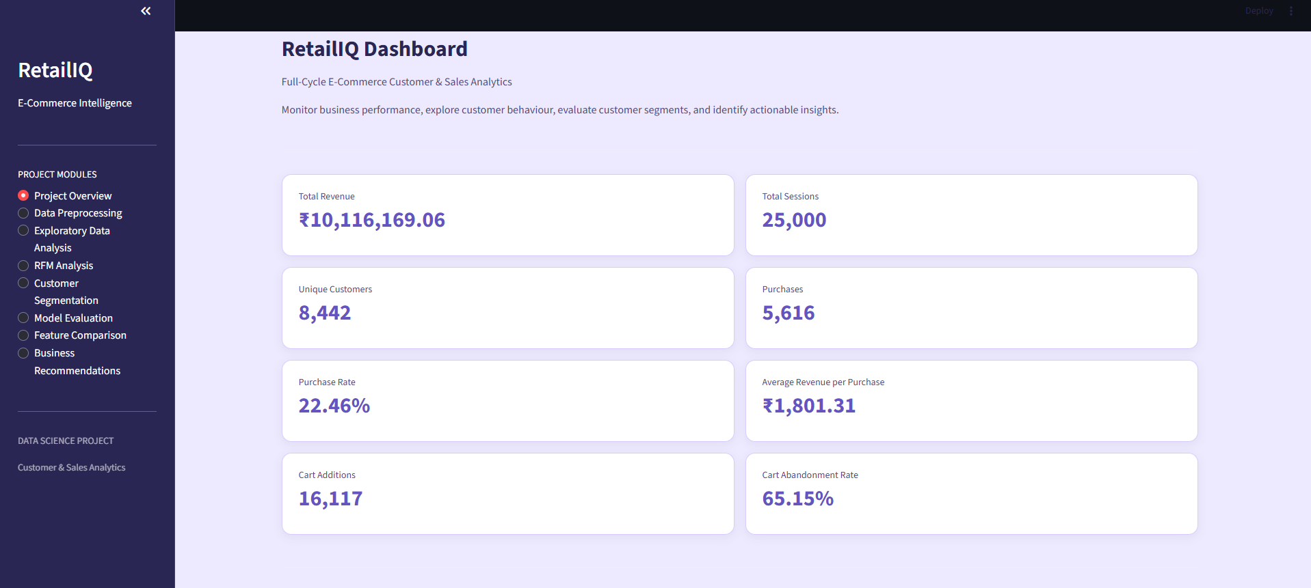
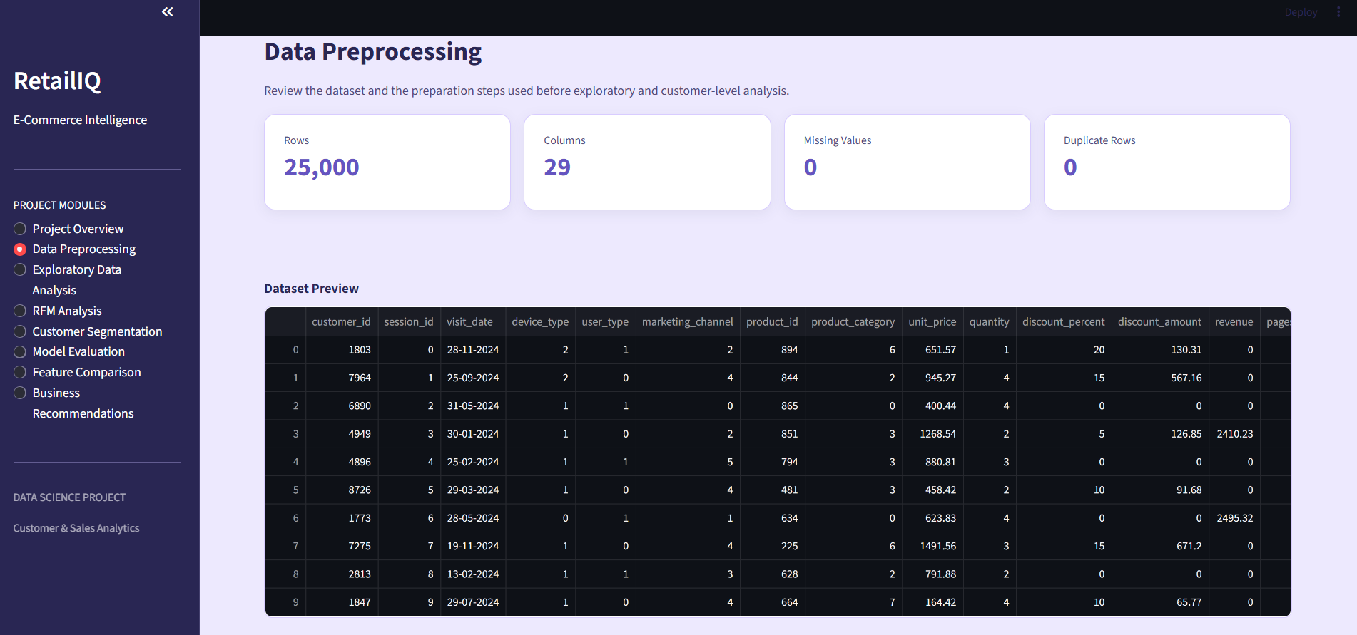
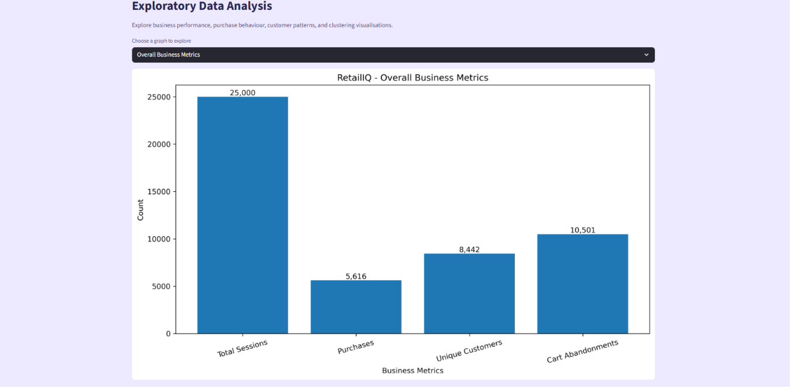
Working Prototype / Output Screens
[Screenshot / photo 1]
[Screenshot / photo 2]
[Screenshot / photo 3]
RetailIQ Dashboard – Overview
Displays key sales metrics, purchase trends, customer activity, and overall e-commerce performance.
Data Processing
Displays the processed dataset and the results of data cleaning and preparation for further analysis.
Exploratory Data Analysis (EDA)
Presents visualizations of sales trends, customer behavior, product performance, and purchasing patterns to identify meaningful insights.
Notes:
Show real screenshots, photos of the hardware or a short demo video link. Caption each one with what the viewer should notice.

Slide 16
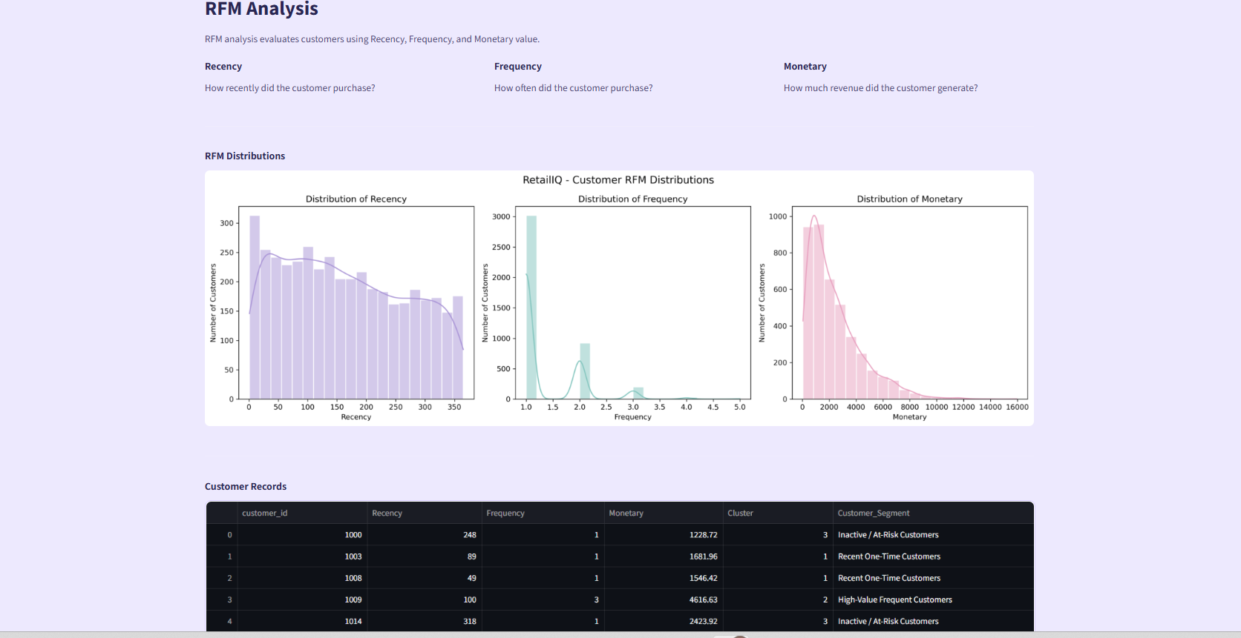
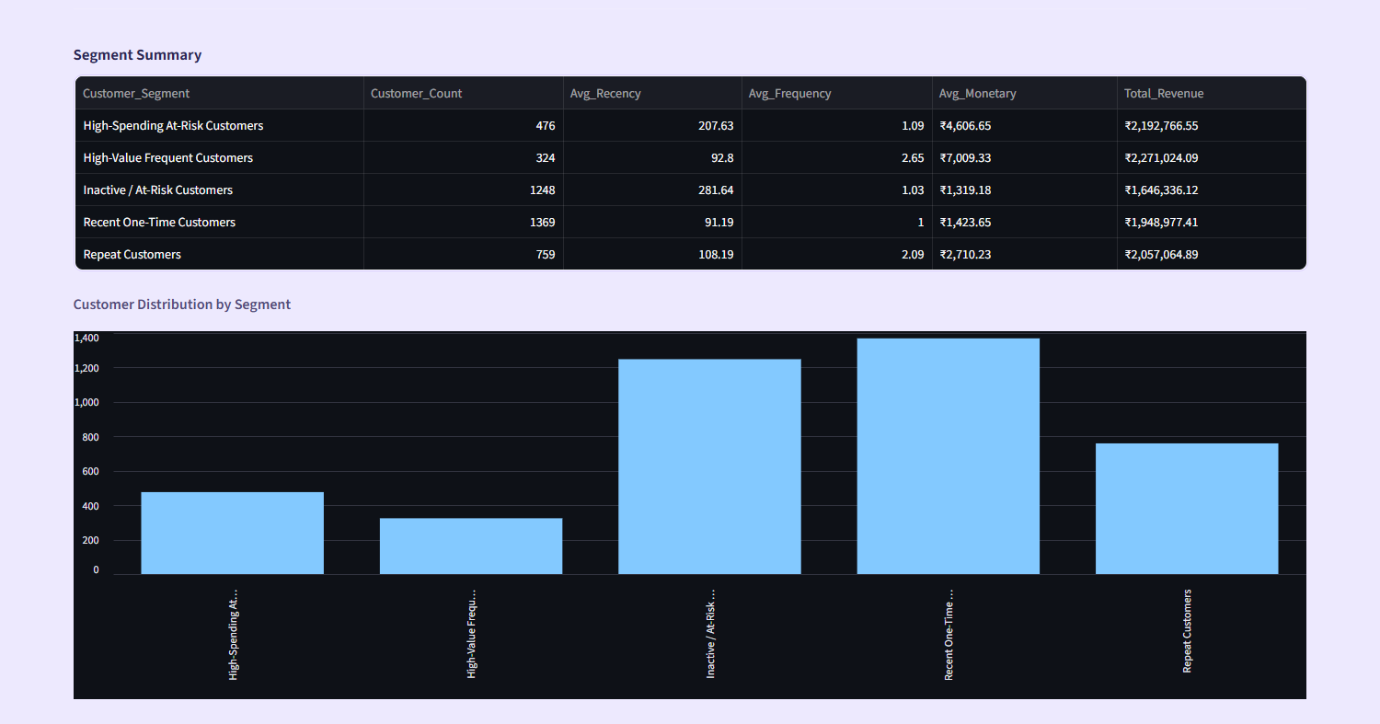
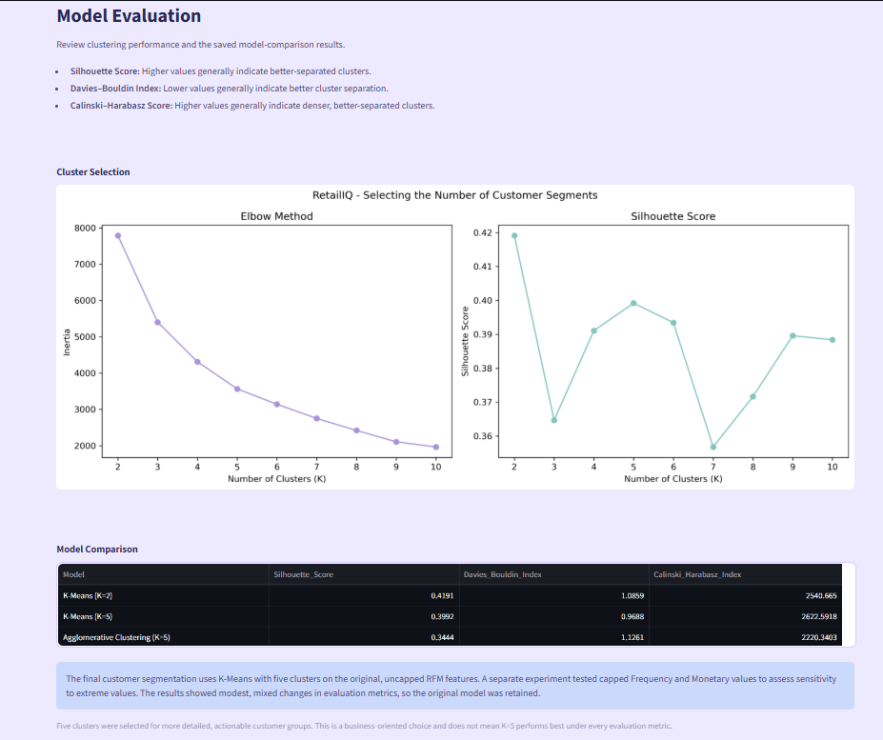
Working Prototype / Output Screens
[Screenshot / photo 1]
[Screenshot / photo 2]
[Screenshot / photo 3]
RFM Analysis
Displays customer-level Recency, Frequency, and Monetary values to analyze purchasing behavior and customer value.
Customer Segmentation
Shows five customer groups identified using K-Means clustering based on RFM features.
Screenshot:
Model Evaluation
Presents clustering performance using Silhouette Score, Davies–Bouldin Index, and Calinski–Harabasz Score.
Notes:
Show real screenshots, photos of the hardware or a short demo video link. Caption each one with what the viewer should notice.

Slide 17
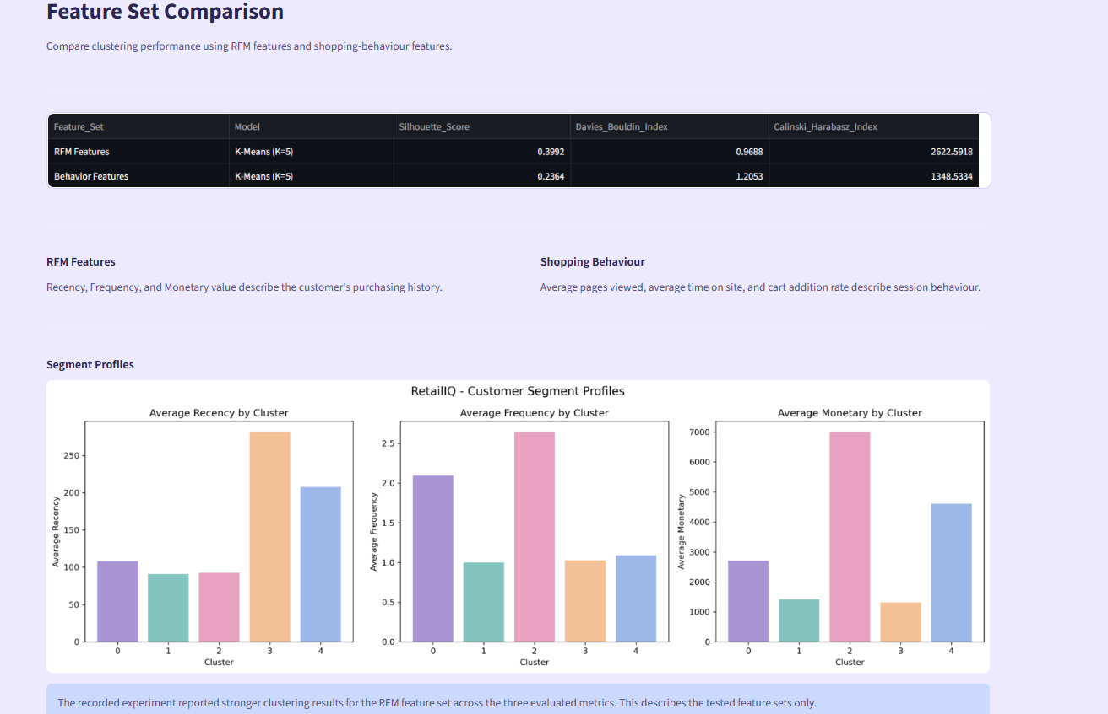
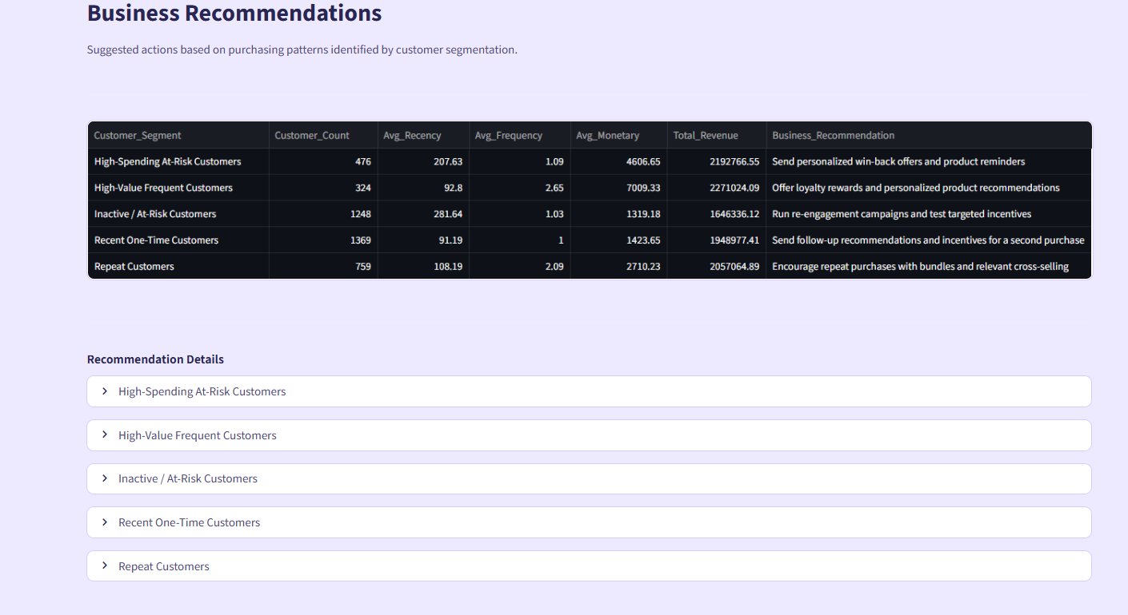
Working Prototype / Output Screens
[Screenshot / photo 1]
[Screenshot / photo 2]
Feature Comparison
Compares clustering configurations and their performance to identify a suitable segmentation approach.
Business Recommendations
Provides actionable suggestions based on customer segments and purchasing behavior to improve sales and customer retention.
Notes:
Show real screenshots, photos of the hardware or a short demo video link. Caption each one with what the viewer should notice.

Slide 18
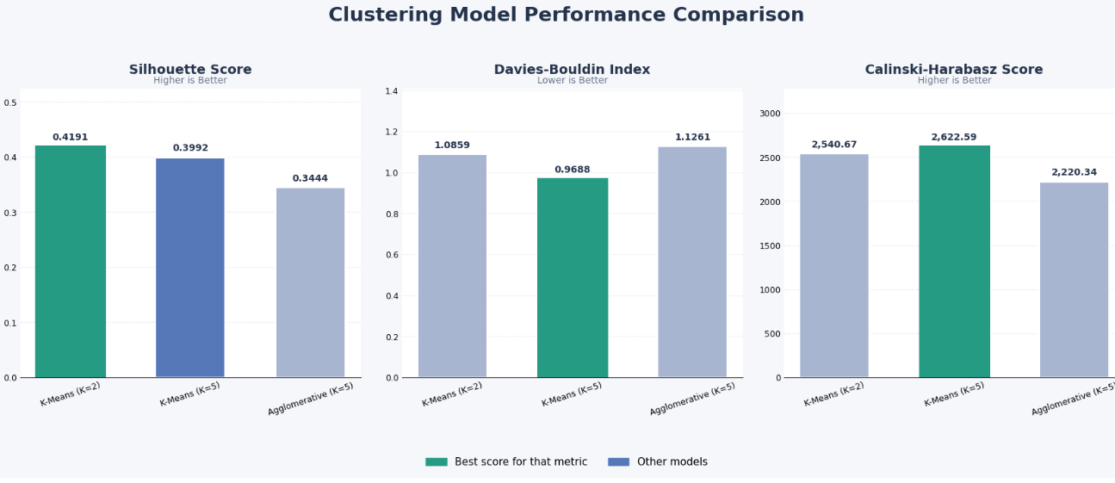
Results & Performance Comparison
Metric | K-Means (K=2) | K-Means (K=5) | Agglomerative (K=5)
Silhouette Score | 0.4191 | 0.3992 | 0.3444
Davies–Bouldin Index | 1.0859 | 0.9688 | 1.1261
Calinski–Harabasz Score | 2540.67 | 2622.59 | 2220.34
Best: K-Means (K=5)– Davies–Bouldin Index = 0.9688
Notes:
Right-click the chart and choose Edit Data to enter your real numbers. Replace the metrics with the ones that fit your project (accuracy, latency, power, throughput, user rating). State clearly which option performed best.

Slide 19
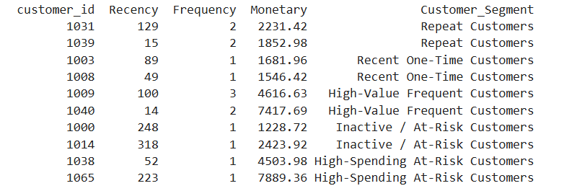
Analysis & Key Findings
[Insert confusion matrix / feature importance /
ROC curve / output comparison]
[0.9688]
Best Davies–Bouldin Index achieved by K-Means (K=5)
Interpretation: Groups 4,176 customers into five segments based on purchasing behaviors.
Error analysis: Similar RFM values and extreme spending patterns may cause overlapping clusters.
Key drivers: Recency, Frequency, and Monetary (RFM) values.
Notes:
Explain what the numbers mean. Use a confusion matrix, ROC curve, feature-importance chart or output comparison. Be honest about weak results; panels value that.

Slide 20

Testing & Validation
Test ID | Test Description | Expected Result | Actual Result | Status
TC-01 | Dataset loading and preprocessing | Dataset loads with 25,000 records and no duplicate rows | Dataset loaded and 25,000 records processed | Pass
TC-02 | RFM feature calculation | Recency, Frequency and Monetary values calculated correctly | RFM values generated for 4,176 purchasing customers | Pass
TC-03 | K-Means customer segmentation | Customers assigned to 5 distinct clusters | 4,176 customers grouped into 5 segments | Pass
TC-04 | Streamlit dashboard functionality | Dashboard displays metrics, graphs and customer segments | Dashboard displays the implemented analytics and visualizations | Pass
Functional Testing
Validation Method
Performance Testing
Tested individual modules (unit testing) and verified the complete workflow, from data preprocessing to dashboard display (integration testing).
Internal validation using Silhouette Score, Davies–Bouldin Index, and Calinski–Harabasz Score to evaluate clustering quality and compare models.
Evaluated clustering quality using performance metrics and checked dashboard responsiveness, data processing, and visualization reliability.
Notes:
List representative test cases with expected and actual outcomes. Name the validation methods you used. Delete rows you do not need.

Slide 21


Challenges & Limitations
Challenges Faced
Limitations
Missing / inconsistent data → Applied data preprocessing and validation.
Customer segmentation → Used RFM analysis to identify purchasing patterns.
Choosing optimal clusters → Compared different clustering configurations using evaluation metrics.
Extreme values → Tested capped and uncapped RFM features and retained the original data.
Visualizing results → Developed an interactive Streamlit dashboard.
Interpreting clusters → Analyzed RFM profiles to assign meaningful customer segment names.
Data Limitation: Uses a single dataset, limiting generalization to other e-commerce businesses.
Historical Data: Relies on past purchases and cannot predict future customer behaviour.
Scope Limitation: Focuses on RFM-based segmentation rather than real-time customer tracking.
Model Limitation: K-Means may be affected by outliers and overlapping customer groups.
Time Limitation: Limited time for testing with multiple datasets and advanced algorithms.
Hardware Limitation: Performance depends on the available computing resources.
Notes:
Be candid. Pair every challenge with how you solved it, and list limitations that the panel would otherwise spot themselves.

Slide 22

Conclusion
Developed RetailIQ, an interactive e-commerce analytics dashboard using Python, Machine Learning, and Streamlit.
1
Final Outcome
Analyzed 25,000 records and segmented 4,176 purchasing customers into five groups using RFM and K-Means.
5 Segments
2
4,176 customers successfully segmented Objectives achieved: 4 of 4 (100%)
K-Means (K=5) achieved a Davies–Bouldin Index of 0.9688, outperforming K-Means (K=2) and Agglomerative Clustering on this metric.
Achieved the objectives by providing customer insights, model comparison, and actionable recommendations for customer retention and sales improvement.
3
Notes:
Revisit each objective and say whether you met it. Quote your headline result with numbers. Do not introduce new material here.

Slide 23



Future Scope & Applications
Improve Performance
Explore advanced clustering algorithms, hyperparameter tuning, and feature optimisation.
Applications
Identify high-value customers and provide personalised offers.
Detect inactive customers and improve customer retention.
Analyze purchasing patterns to support sales and marketing decisions.
Potential Adopters: E-commerce companies, online retailers, marketing teams, and business analysts.
Expand Data / Features
Include larger datasets, customer demographics, product preferences, and real-time purchase behaviour.
Deploy & Build an Interface
Enhance the Streamlit dashboard and deploy it as a web application with API support.
Scale & Secure
Integrate cloud deployment, data privacy measures, and scalable data processing for larger datasets.
Notes:
Give concrete next steps, ideally tied to the limitations. Then name two or three real-world uses.

Slide 24
Team Contribution
Reg. No. | Name | Contribution / Modules Handled
2420030067 | Lakshman Angara | Data collection, preprocessing, Customer Segmentation
2420030185 | Ivaturi Vennela | RFM Analysis, Exploratory Data Analysis
2420030630 | Vishnu Priya Kodali | Model Evaluation, Comparative Analysis ,Interactive Dashboard and Business Recommendations
Notes:
Show that work was planned and shared. Every member should be able to explain their own module.

Slide 25

References
[1] C.-G. Wong, G.-K. Tong, and S.-C. Haw, “Exploring Customer Segmentation in E-Commerce using RFM Analysis with Clustering Techniques,” Journal of Telecommunications and the Digital Economy, vol. 12, no. 3, pp. 97–125, 2024. [Online]. Available: https://doi.org/10.18080/jtde.v12n3.978
[2] J. B. MacQueen, “Some Methods for Classification and Analysis of Multivariate Observations,” in Proc. Fifth Berkeley Symposium on Mathematical Statistics and Probability, vol. 1, 1967, pp. 281–297.
[3] P. J. Rousseeuw, “Silhouettes: A Graphical Aid to the Interpretation and Validation of Cluster Analysis,” Journal of Computational and Applied Mathematics, vol. 20, pp. 53–65, 1987.
[4] D. L. Davies and D. W. Bouldin, “A Cluster Separation Measure,” IEEE Transactions on Pattern Analysis and Machine Intelligence, vol. PAMI-1, no. 2, pp. 224–227, 1979.
[5] Scikit-learn, “Clustering — K-Means and Clustering Performance Evaluation.” [Online]. Available: https://scikit-learn.org/stable/modules/clustering.html
[6] Streamlit, “Streamlit Documentation.” [Online]. Available: https://docs.streamlit.io/
[7] K. Bedmutha, “Indian E-Commerce Customer Behavior and Purchase Dataset,” Kaggle. [Online]. Available: https://www.kaggle.com/datasets/kundanbedmutha/indian-e-commerce-customer-behavior-and-purchase
Project Links
GitHub:
https://github.com/VishnuPriyaKodali/KLH-CSE-2026-27-2420030630-RetailIQ-Full-Cycle-E-Commerce-Customer-Sales-Analytics
https://github.com/lakshman067/KLH-CSE-2026-27-2420030067-RetailIQ-Full-Cycle-E-Commerce-Customer-Sales-Analytics
https://github.com/vennelaa27/KLH-CSE-2026-27-2420030185-RetaillQ-Full-Cycle-E-Commerce-Customer-Sales-Analytics
Dataset: https://www.kaggle.com/datasets/kundanbedmutha/indian-e-commerce-customer-behavior-and-purchase
Notes:
Use IEEE style, numbered in order of first citation in the deck. Include datasets, documentation and code repositories.

Slide 26
THANK YOU
Questions & Discussion
[2420030067@klh.edu.in, 24200030185@klh.edu.in,2420030630@klh.edu.in]
[Dr. N. Sunanda, Department Of CSE]
Notes:
Leave this slide up during questions. Make sure every team member can answer questions about their own module.

